Slide 1
Biological Networks Analysis Degree Distribution and Network Motifs
Genome 559: Introduction to Statistical and Computational Genomics
Elhanan Borenstein

Slide 2
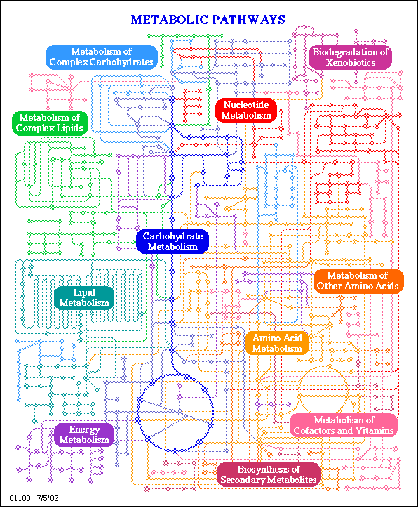
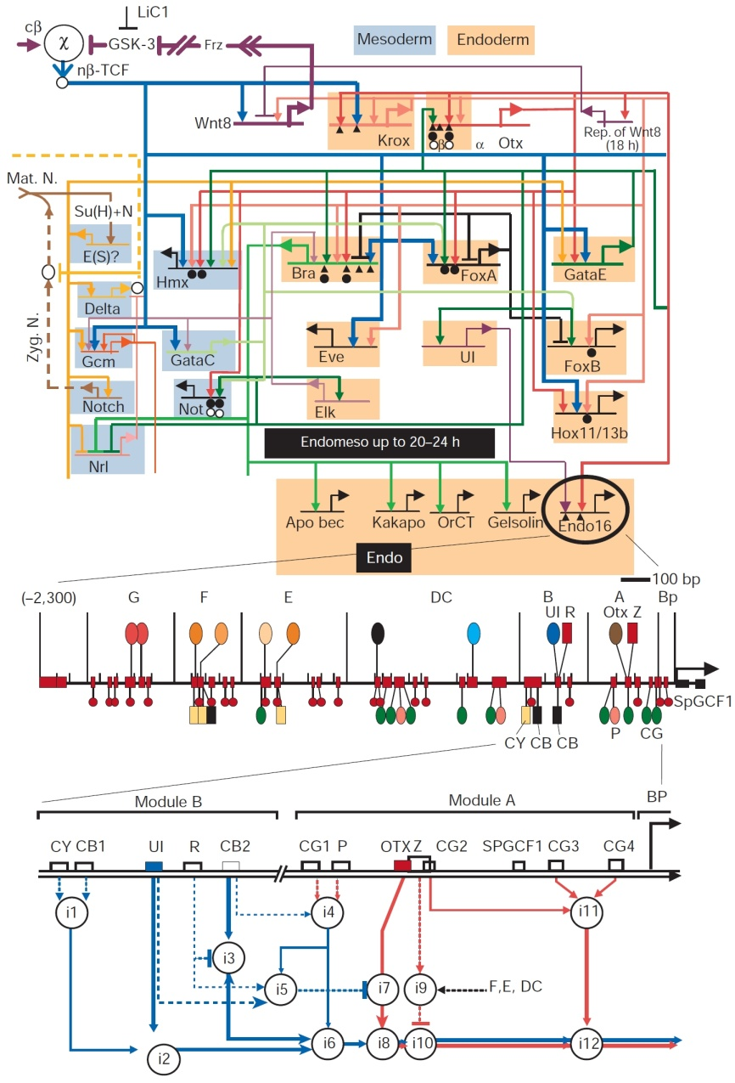
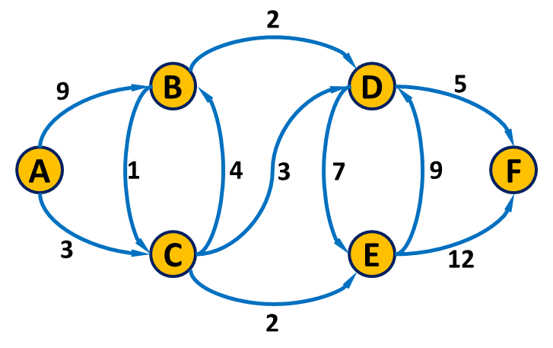
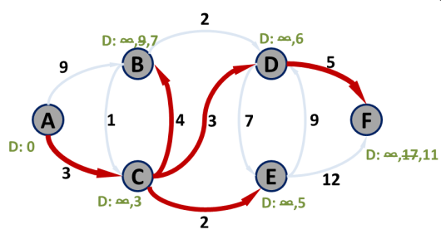
A quick review
Networks:
Networks vs. graphs
A collection of nodes and links
Directed/undirected; weighted/non-weighted, …
Networks as models vs. networks as tools
Many types of biological networks
The shortest path problem
Dijkstra’s algorithm
Initialize: Assign a distance value, D, to each node. Set D=0 for start node and to infinity for all others.
For each unvisited neighbor of the current node: Calculate tentative distance, D^{t}, through current node and if D^{t} < D: D← D^{t}. Mark node as visited.
Continue with the unvisited node with the smallest distance

Slide 3
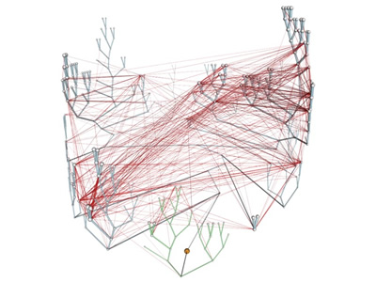
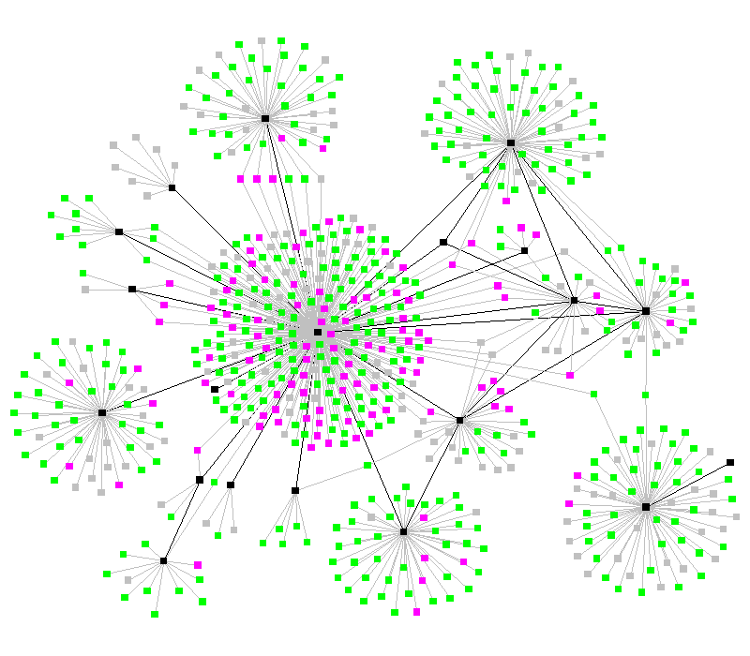
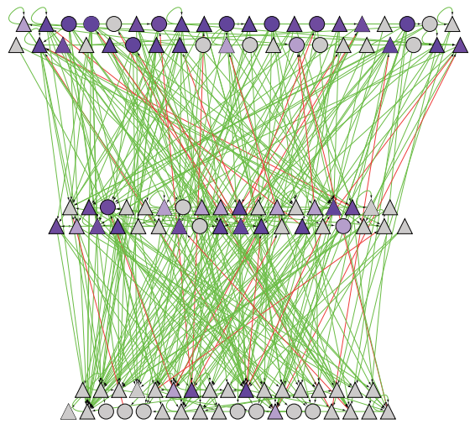
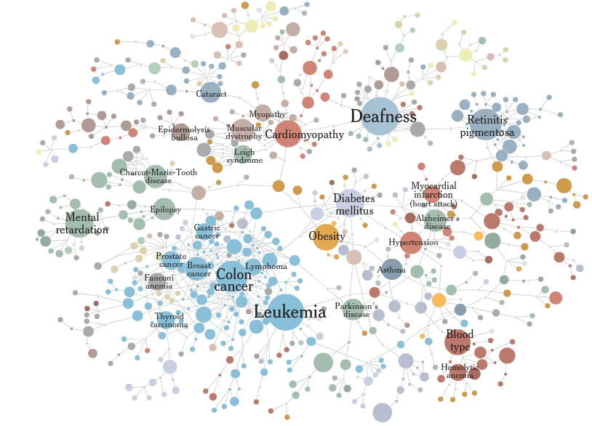
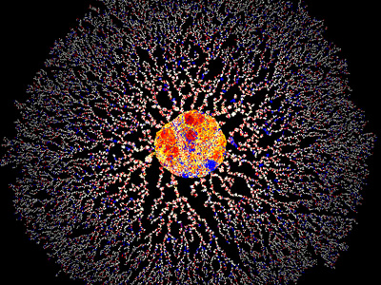
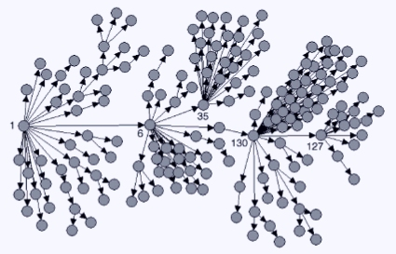
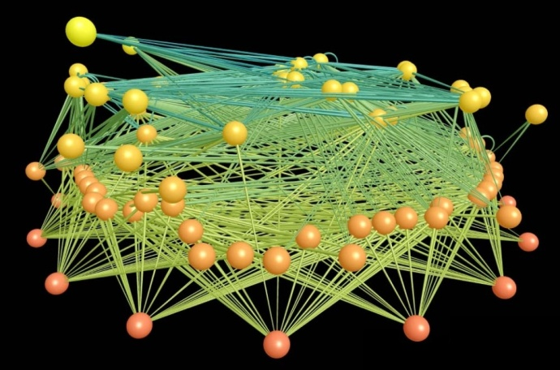
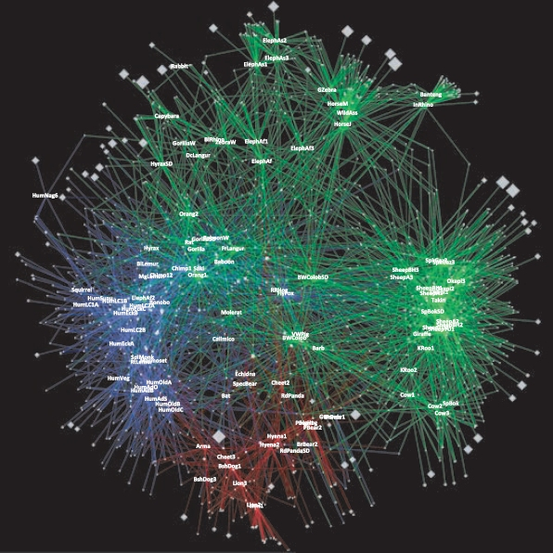
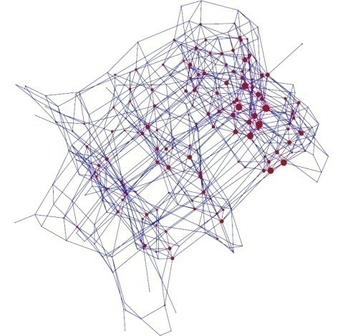
Networks in biology/ecology/medicine
Notes:
PROTEIN HOMOLOGY NETWORK

Slide 4
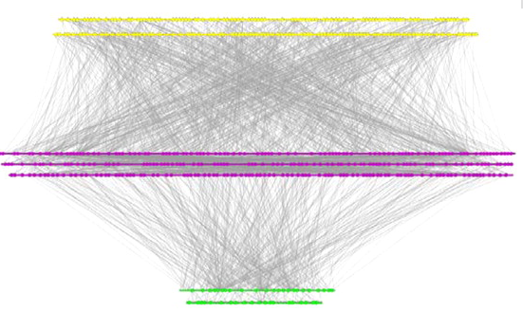
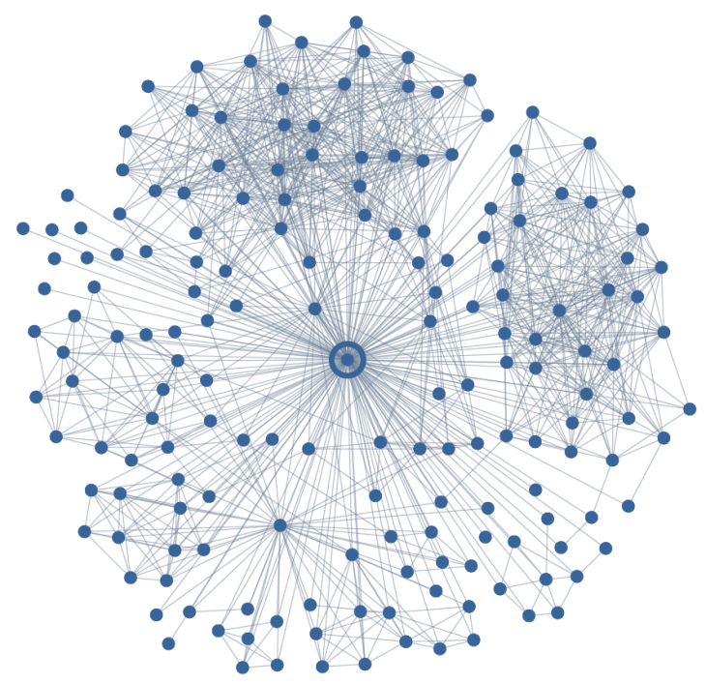
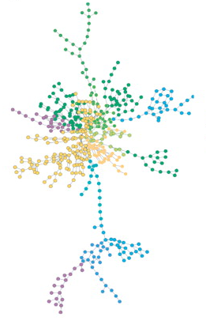
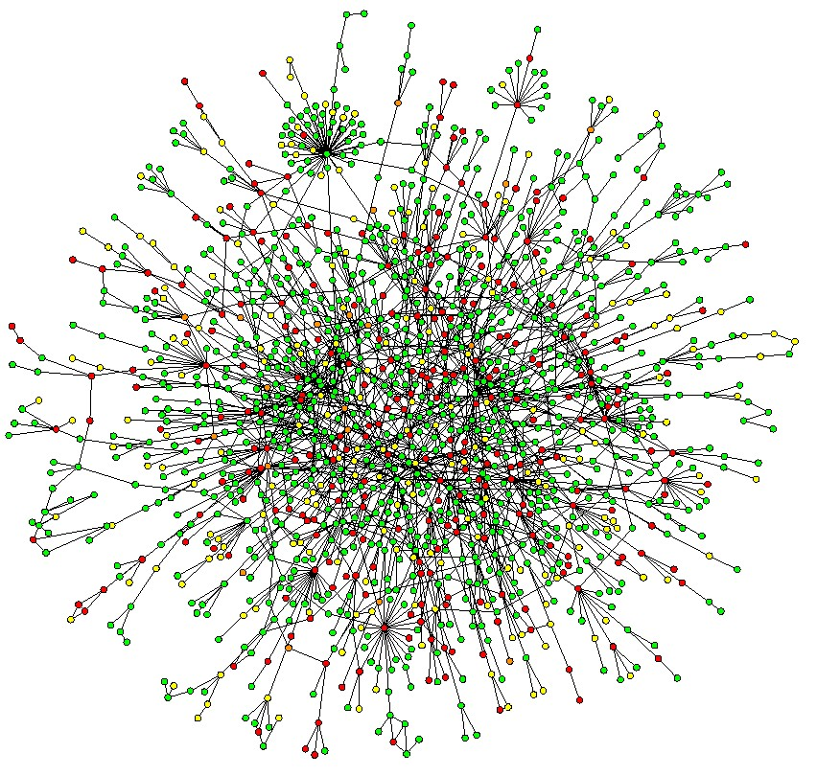
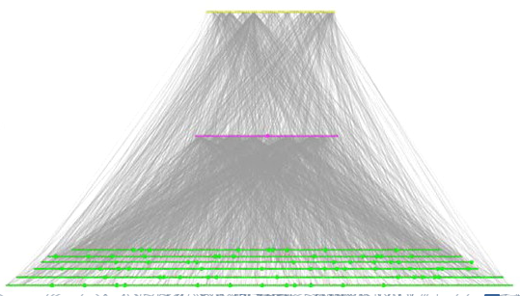

Slide 5
Comparing networks
We want to find a way to “compare” networks.
“Similar” (not identical) topology
“Common” design principles
We seek measures of network topology that are:
Simple
Capture global organization
Potentially “important”
(equivalent to, for example, GC content for genomes)
Summary statistics

Slide 6
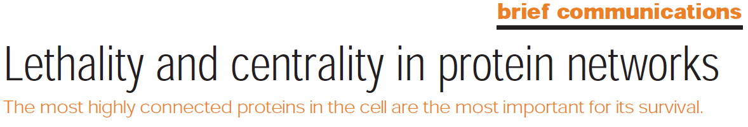
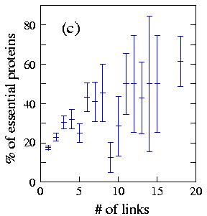
Node degree / rank
Degree = Number of neighbors
Node degree in PPI networks correlates with:
Gene essentiality
Conservation rate
Likelihood to cause human disease

Slide 7
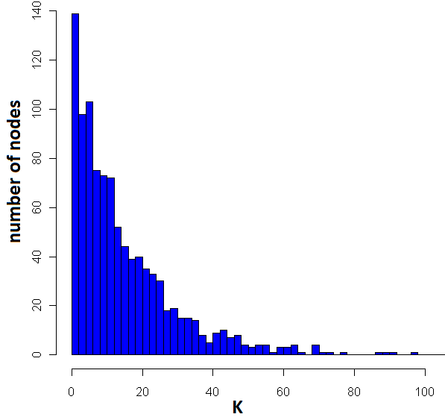
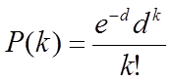
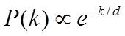
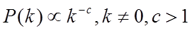
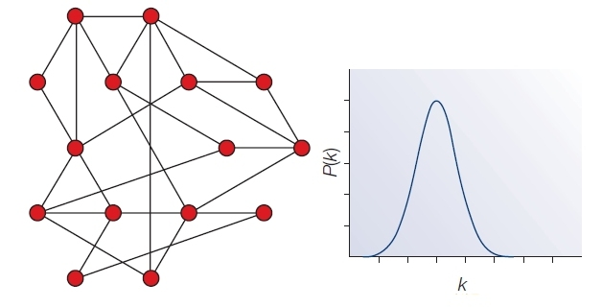
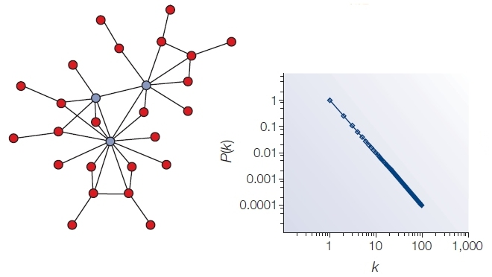
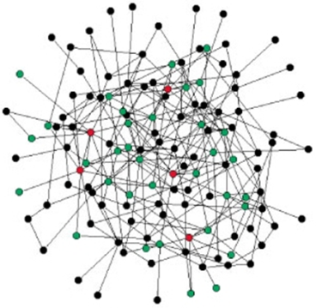
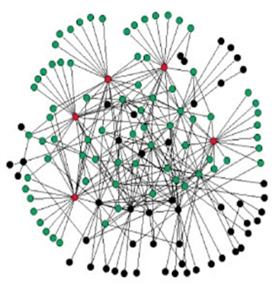
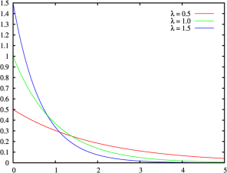
Degree distribution
P(k): probability that a node has a degree of exactly k
Common distributions:
Poisson:
Exponential:
Power-law:

Slide 8
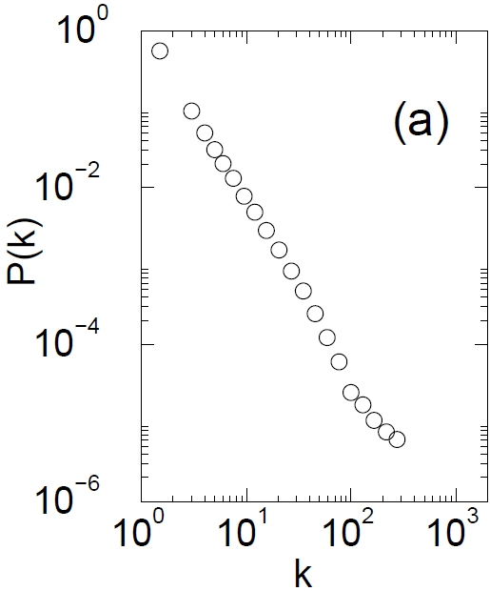
The Internet
Nodes – 150,000 routers
Edges – physical links
P(k) ~ k^{-2.3}
Govindan and Tangmunarunkit, 2000

Slide 9


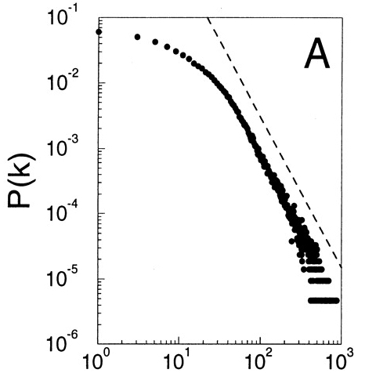
Movie actor collaboration network
Tropic Thunder (2008)
Nodes – 212,250 actors
Edges – co-appearance in a movie
P(k) ~ k^{-2.3}
Barabasi and Albert, Science, 1999
Notes:
(<k> = 28.78) tom cruise

Slide 10
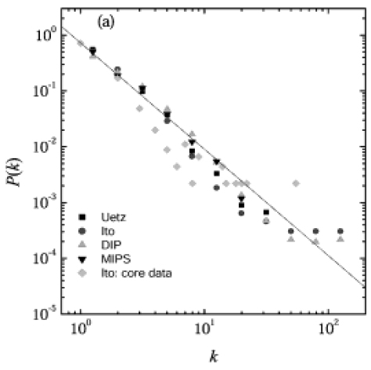
Protein protein interaction networks
Nodes – Proteins
Edges – Interactions (yeast)
P(k) ~ k^{-2.5}
Yook et al, Proteomics, 2004

Slide 11
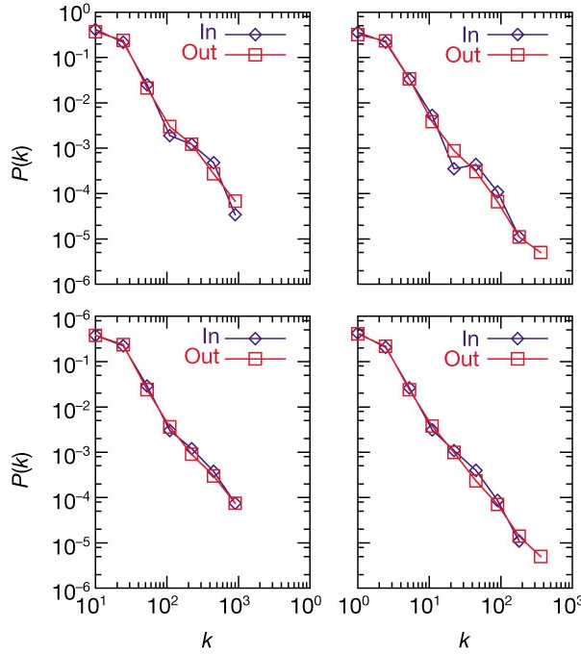
Metabolic networks
Nodes – Metabolites
Edges – Reactions
P(k) ~ k^{-2.2±2}
A.Fulgidus (archae)
E. Coli (bacterium)
Metabolic networks across all kingdoms of life are scale-free
C.Elegans (eukaryote)
Averaged (43 organisms)
Jeong et al., Nature, 2000

Slide 12
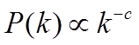
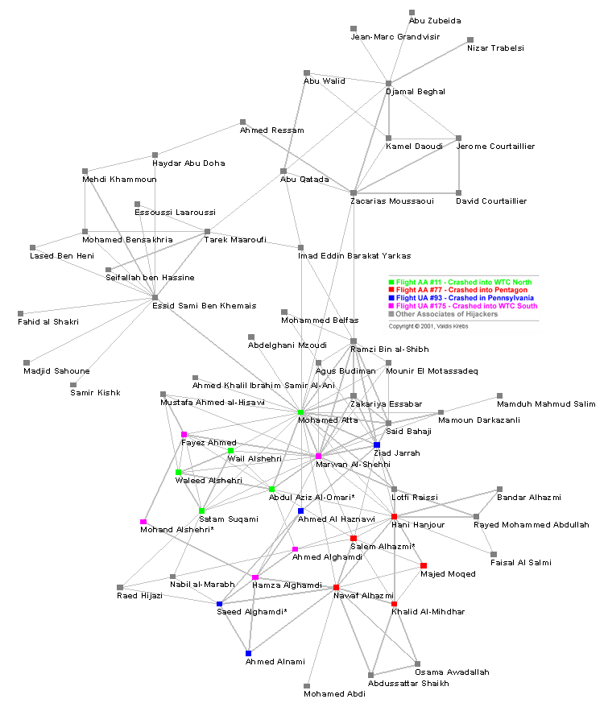
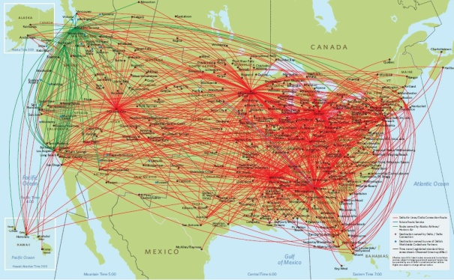
The power-law distribution
Power-law distribution has a “heavy” tail!
Characterized by a small number of highly connected nodes, known as hubs
A.k.a. “scale-free” network
Hubs are crucial:
Affect error and attack tolerance of complex networks (Albert et al. Nature, 2000)

Slide 13
Why do so many real-life networks exhibit a power-law degree distribution?
Is it “selected for”?
Is it expected by chance?
Does it have anything to do with the way networks evolve?
Does it have functional implications?
?

Slide 14
Network motifs
Going beyond degree distribution …
Generalization of sequence motifs
Basic building blocks
Evolutionary design principles?

Slide 15
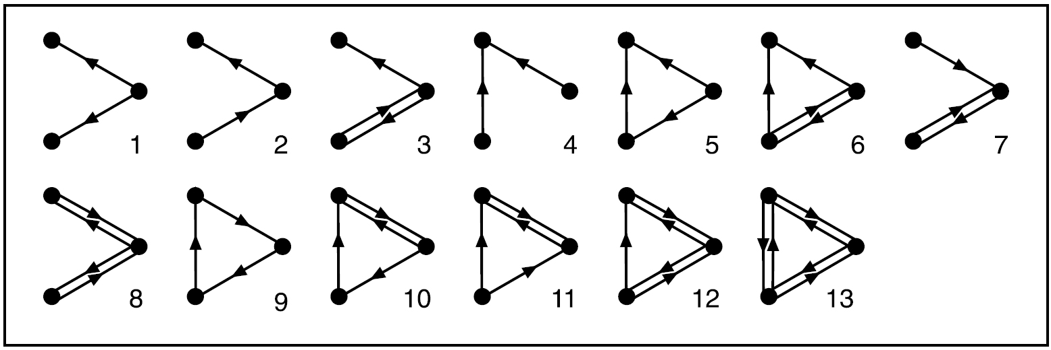
What are network motifs?
Recurring patterns of interaction (sub-graphs) that are significantly overrepresented (w.r.t. a background model)
13 possible 3-nodes sub-graphs
(199 possible 4-node sub-graphs)
R. Milo et al. Network motifs: simple building blocks of complex networks. Science, 2002

Slide 16
Finding motifs in the network
1a. Scan all n-node sub-graphs in the real network
1b. Record number of appearances of each sub-graph (consider isomorphic architectures)
2. Generate a large set of random networks
3a. Scan for all n-node sub-graphs in random networks
3b. Record number of appearances of each sub-graph
4. Compare each sub-graph’s data and identify motifs

Slide 17
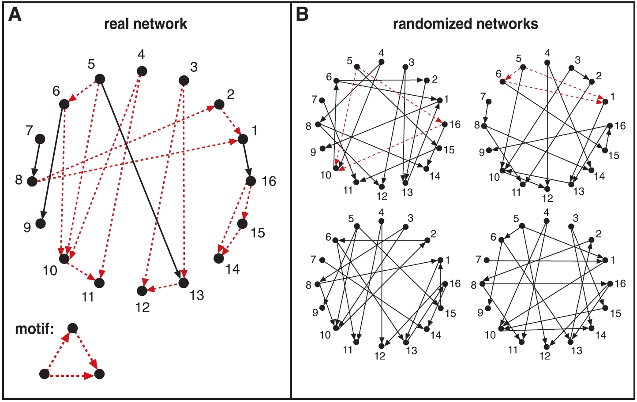
Finding motifs in the network

Slide 18
Network randomization
How should the set of random networks be generated?
Do we really want “completely random” networks?
What constitutes a good null model?

Slide 19
Network randomization
How should the set of random networks be generated?
Do we really want “completely random” networks?
What constitutes a good null model?
Preserve in- and out-degree

Slide 20
Generation of randomized networks
Network randomization algorithm :
Start with the real network and repeatedly swap randomly chosen pairs of connections (X1→Y1, X2→Y2 is replaced by X1→Y2, X2→Y1)
(Switching is prohibited if the either of the X1→Y2 or X2→Y1 already exist)
Repeat until the network is “well randomized”
X1
Y1
X1
Y1
X2
Y2
X2
Y2
Notes:
The two algorithms gave identical results for the sub graph statistics.

Slide 21
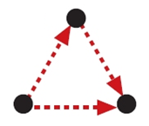
Motifs in transcriptional regulatory networks
E. Coli network
424 operons (116 TFs)
577 interactions
Significant enrichment of motif # 5
(40 instances vs. 7±3)
X
Master TF
Y
Specific TF
Z
Target
Feed-Forward Loop (FFL)
S. Shen-Orr et al. Nature Genetics 2002
Notes:
Coherent FFLs:
The direct effect of x on z has the same sign as the net indirect effect through y
85% of FFLs are coherent

Slide 22
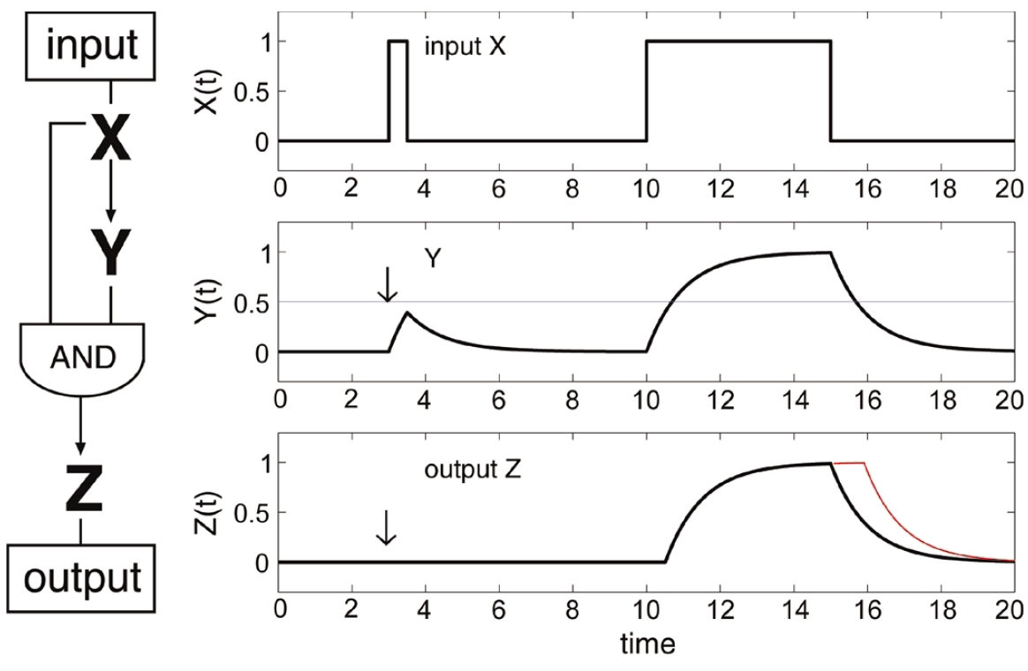
What’s so interesting about FFLs
Boolean Kinetics
A simple cascade has slower shutdown
A coherent feed-forward loop can act as a circuit that rejects transient activation signals from the general transcription factor and responds only to persistent signals, while allowing for a rapid system shutdown.
Notes:
Assume X and Y act on Z as an AND gate
T – Threshold, a – degradation rate

Slide 23
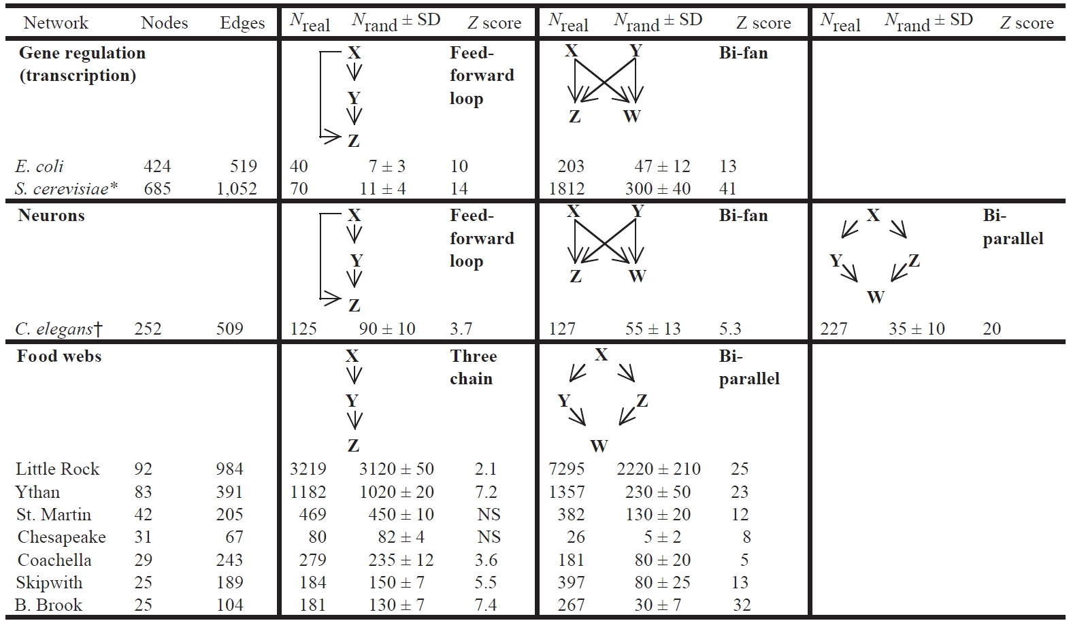
Network motifs in biological networks

Slide 24
Network motifs in biological networks

Slide 25
Network motifs in biological networks

Slide 26
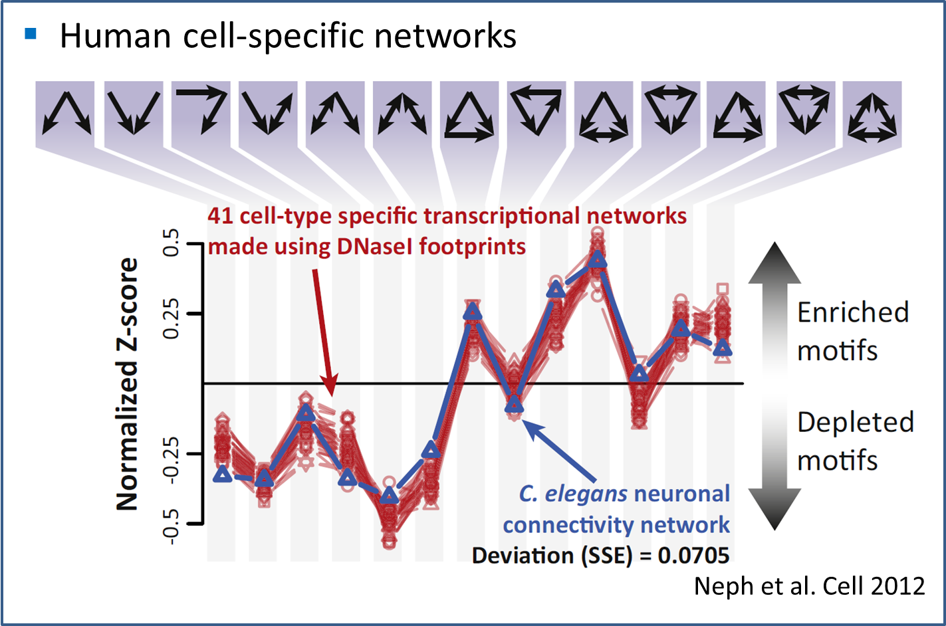
Network motifs in biological networks

Slide 27
Network motifs in biological networks

Slide 28
Network motifs in biological networks
Why do these networks have similar motifs?
Why is this network so different?
FFL motif is under-represented!
Notes:
Information flow vs. Energy Flow

Slide 29
Information Flow vs. Energy Flow
FFL motif is under-represented!
Notes:
Information flow vs. Energy Flow

Slide 30
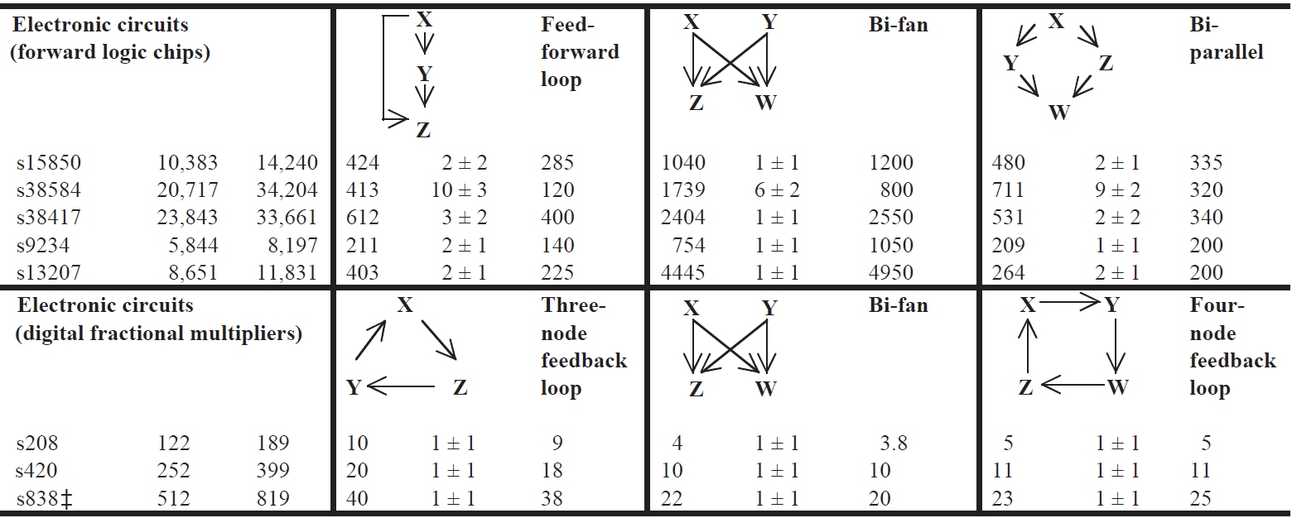
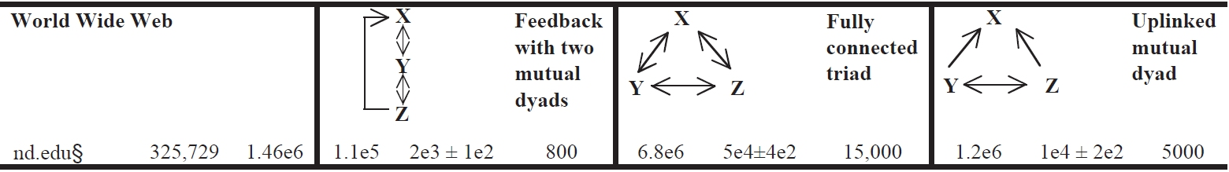
Network Motifs in Technological Networks

Slide 31
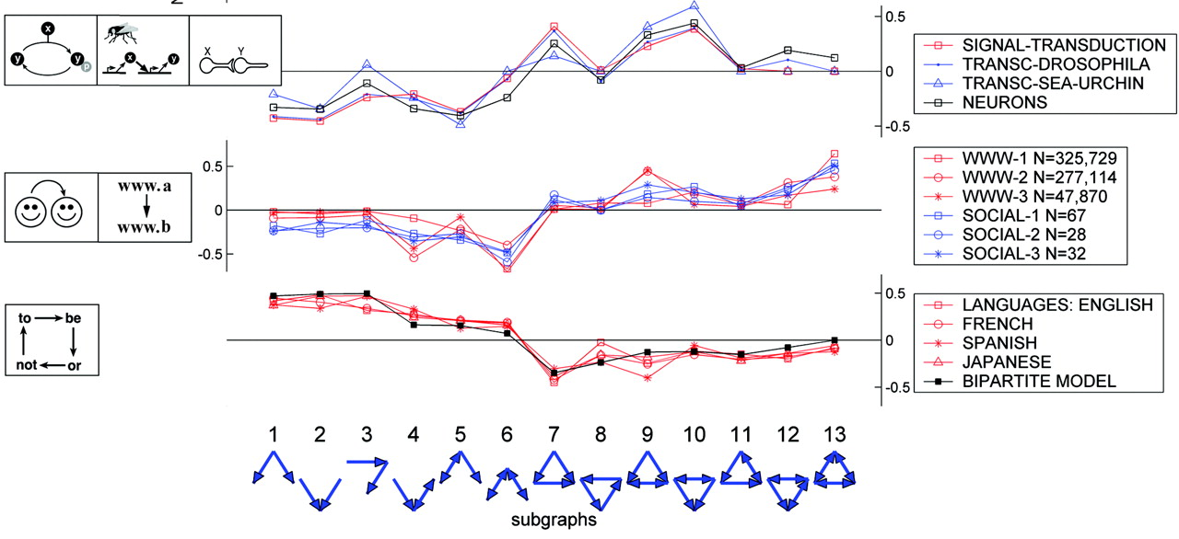
Motif-based network super-families
R. Milo et al. Superfamilies of evolved and designed networks. Science, 2004

